Slide 1

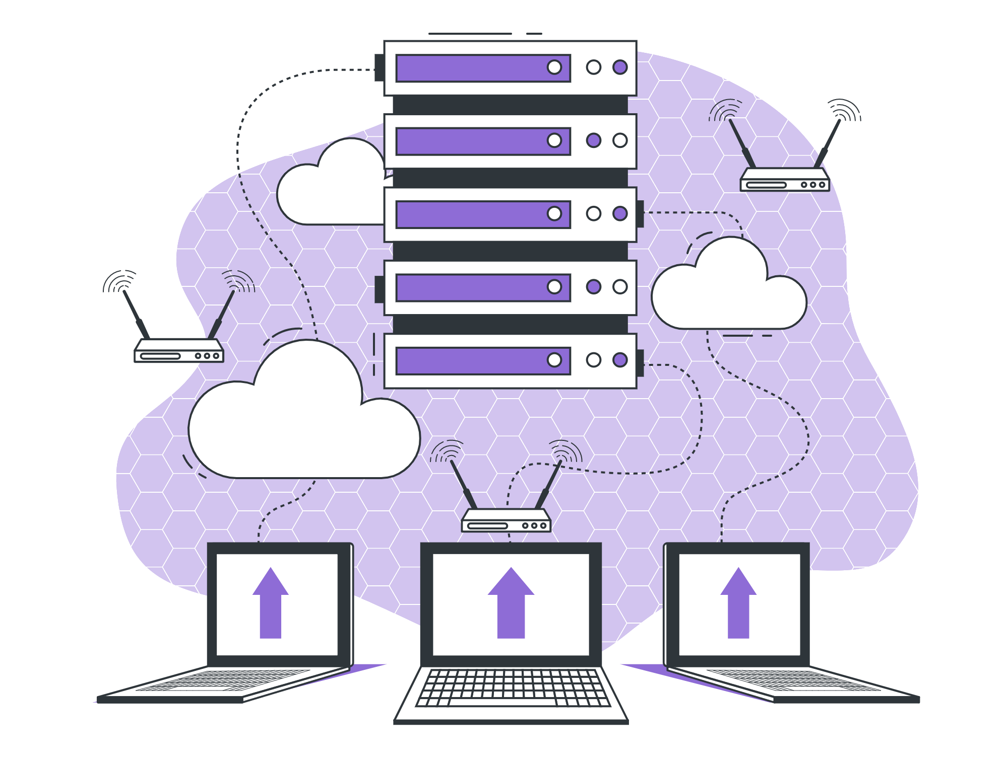
RDBMS Intro

Slide 2

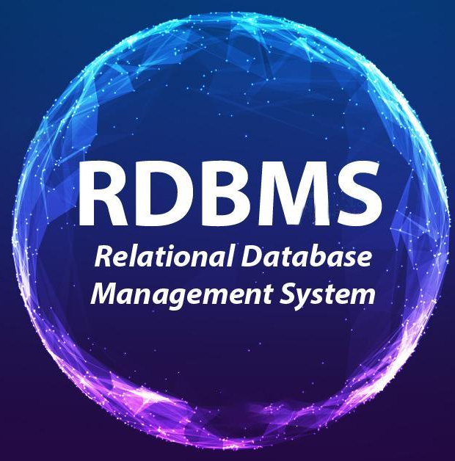
Lecture Checklist
Need of RDBMS.
Introduction to RDBMS.
Important Terminologies.
Why Industries use RDBMS.

Slide 3

Need of RDBMS
Evolution of Internet Applications.

Slide 4

Need of RDBMS
Entities & Relationships.

Slide 5


Need of RDBMS
vs

Slide 6
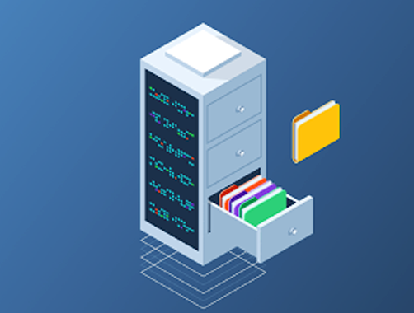
Important Terminologies
Data.
Database.

Slide 7
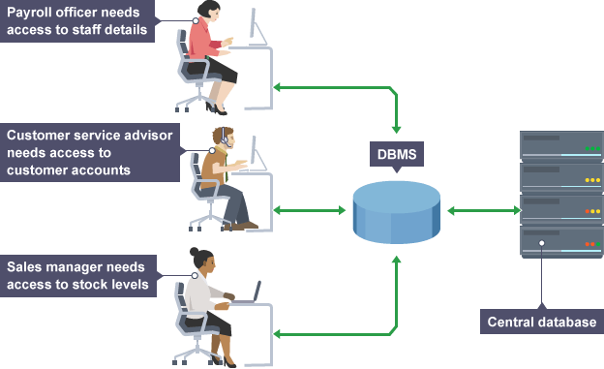
Important Terminologies
DBMS

Slide 8
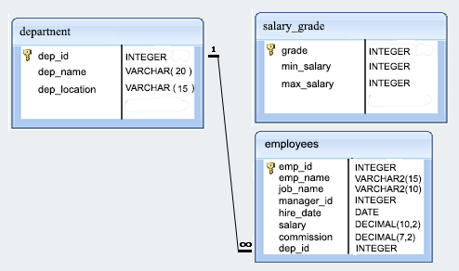
Important Terminologies
Relational Data.

Slide 9
RDBMS
RELATIONAL
DATABASE
MANAGEMENT
SYSTEM

Slide 10
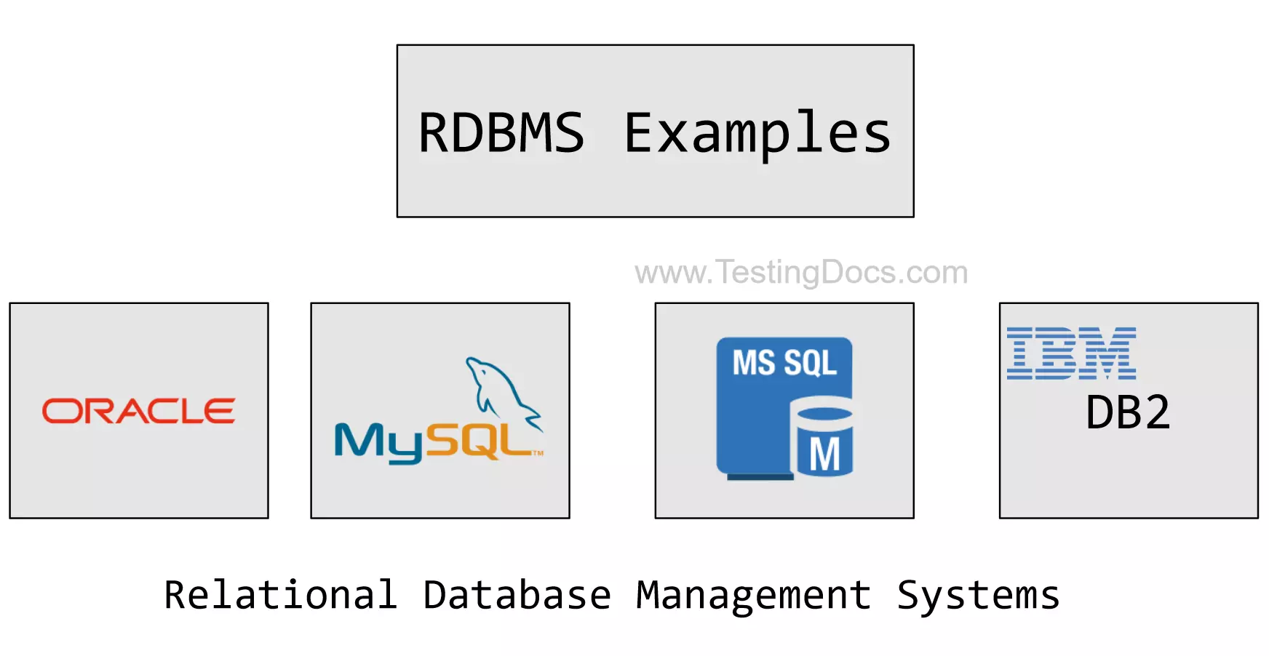
RDBMS
RDBMS Examples
Relational Database Management System

Slide 11

Why do Industries use RDBMS?
Supports transactions.

Slide 12
Why do Industries use RDBMS?
Relationships.

Slide 13
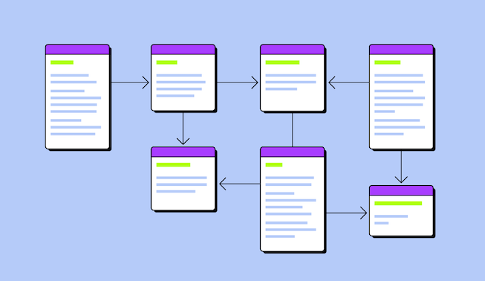
Why do Industries use RDBMS?
Proper Schema.

Slide 14
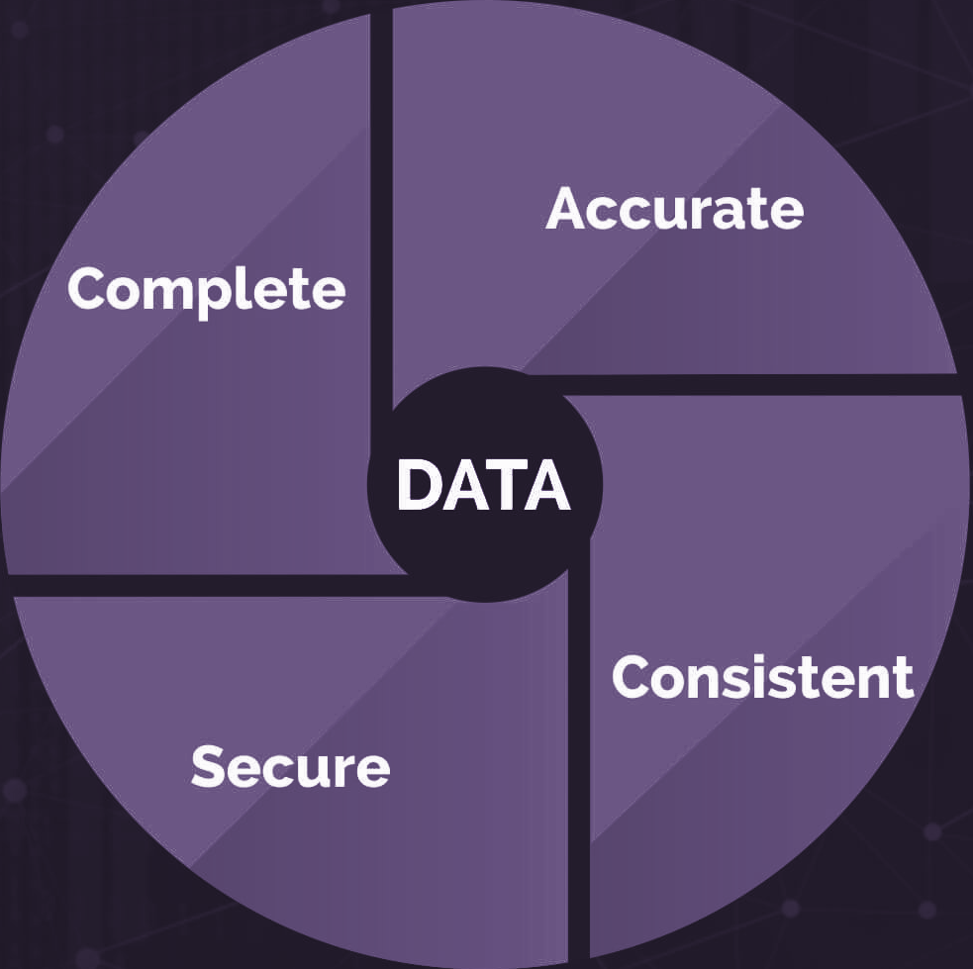
Why do Industries use RDBMS?
Ensures Data Integrity during read and write.
DATA INTEGRITY

Slide 15
THANK YOU

